Slide 1
Basic programming and their extension
C > PROGRAMNAME.C
JAVA> PROGRAMNAME.JAVA
C++> PROGRAMNAME.CPP
Terraform> PROGRAMNAME.tf [main.tf by default]

Slide 2
Open file with main.tf
vi main.tf
Best practice:
mkdir terraform ; cd terraform ; vi main.tf

Slide 3
How to write terraform code?
Prework: Identify the cloud provider, and what you want to create. Click on user provider to get initial code for main.tf

Slide 4
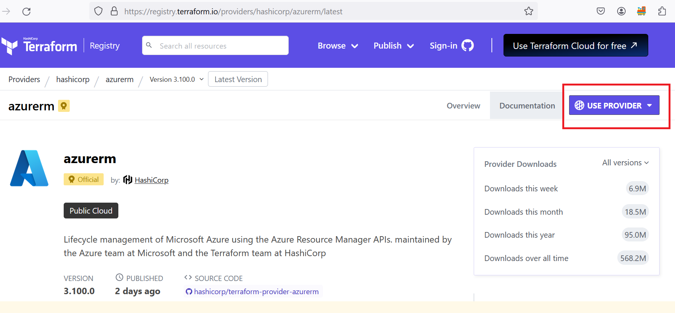
Providers documentation

Slide 5
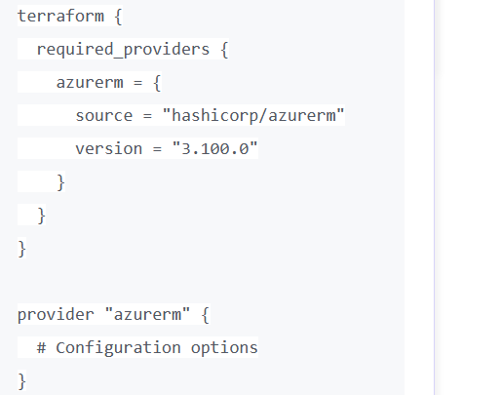
Main.tf

Slide 6
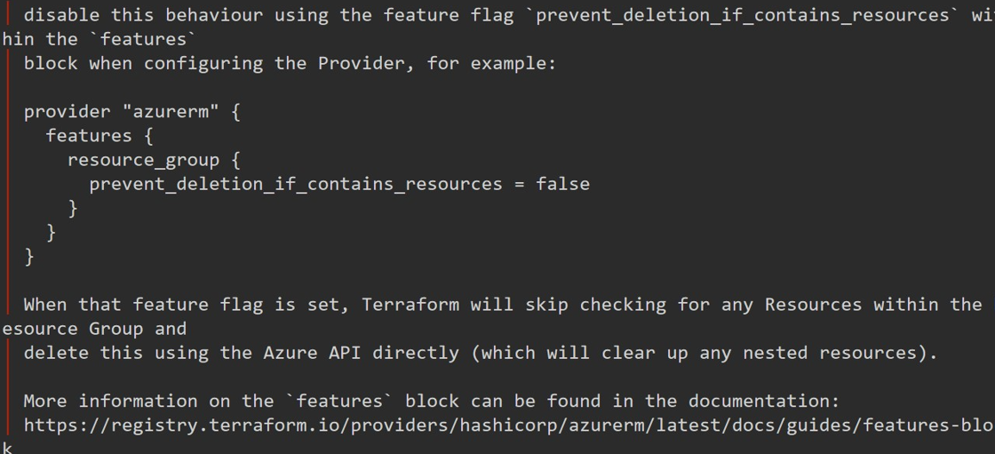
Replace #configuration options with features {}

Slide 7
Common code for all main.tf Azure
terraform {
required_providers {
azurerm = {
source = "hashicorp/azurerm"
version = "3.108.0"
}
}
}
provider "azurerm" {
features {}
}

Slide 8
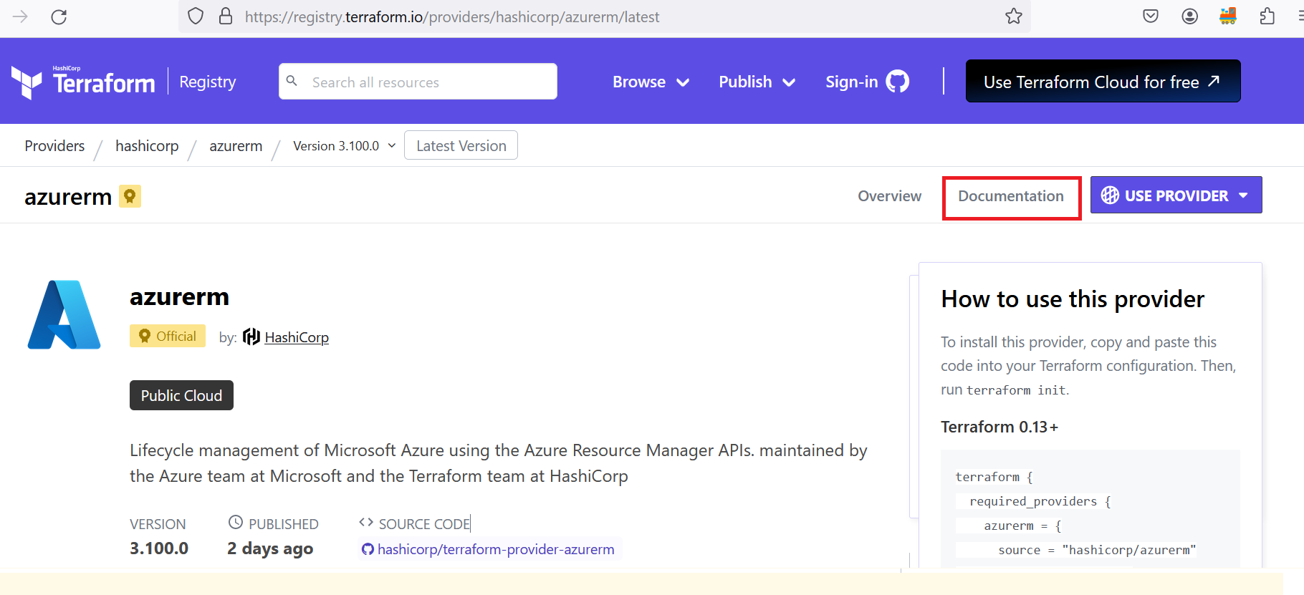
Now click on Azure documentation, and search what you want to create

Slide 9
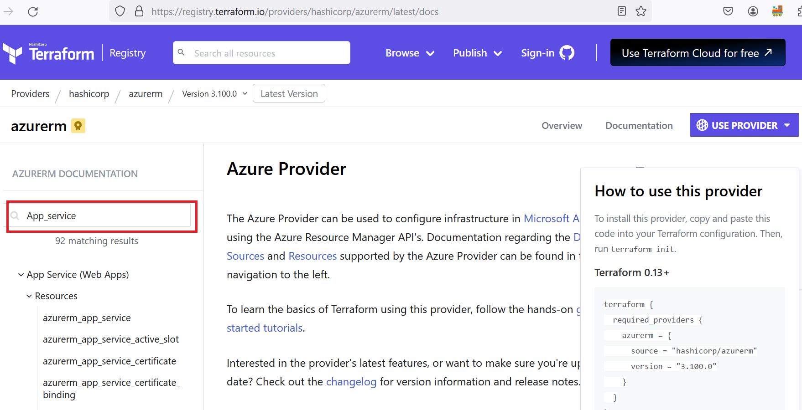

Slide 10
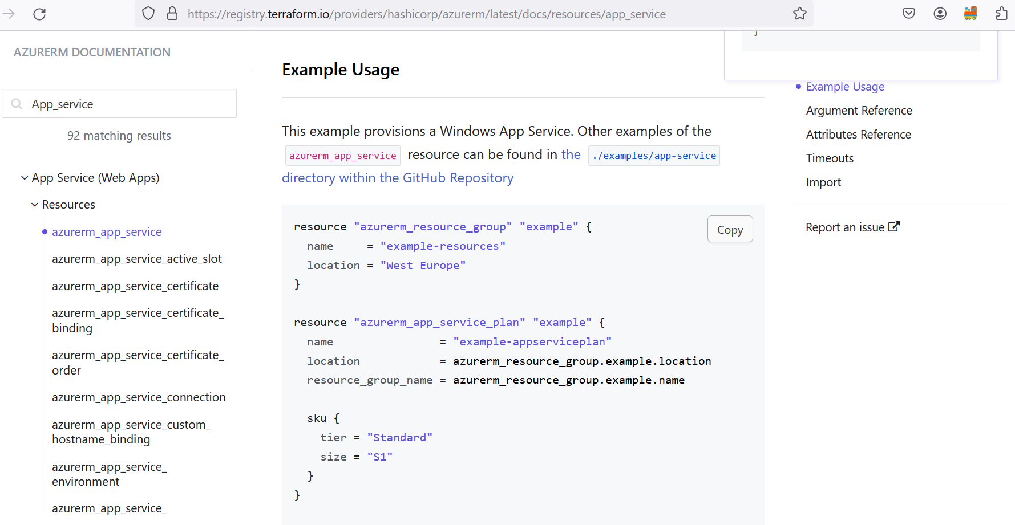

Slide 11
Terraform basics commands
terraform fmt > formatting main.tf
terraform validate > just to see if I am writing correct things or not
terraform init > Initialization purpose.
terraform plan > Just to show summary what you are going to do.
terraform apply > to create infrastructure.
terraform destroy > to delete infrastructure.

Slide 12
